Slide 1
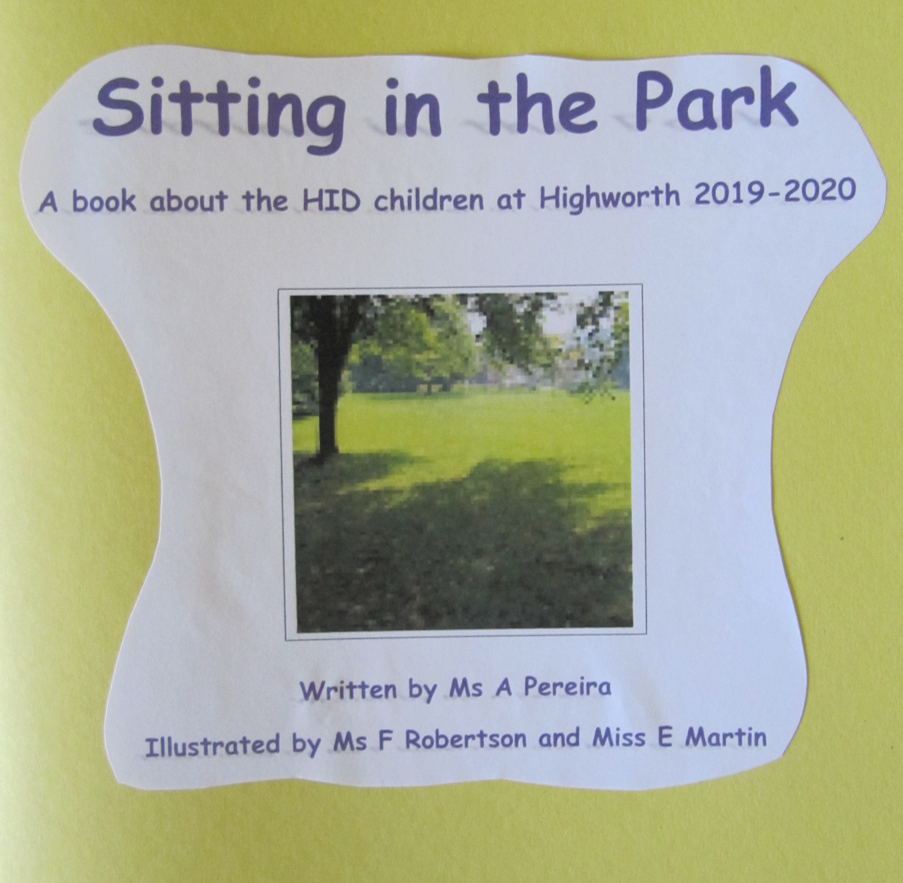

Slide 2
Dear HID Children, I have written a little poem about you in this book. As you read it can you find you and all the other HID children?

Slide 3
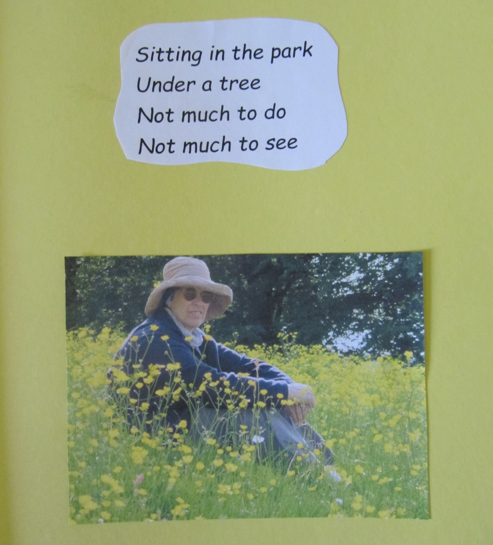

Slide 4
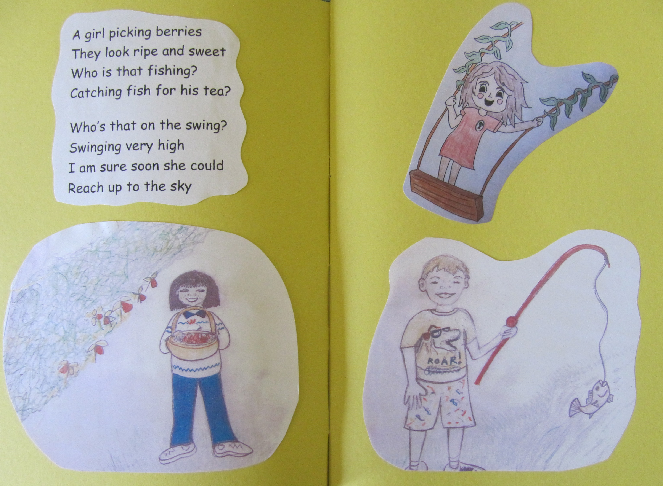

Slide 5
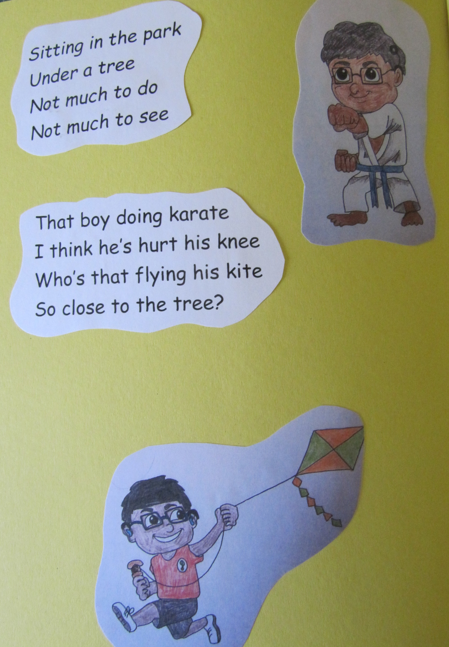

Slide 6
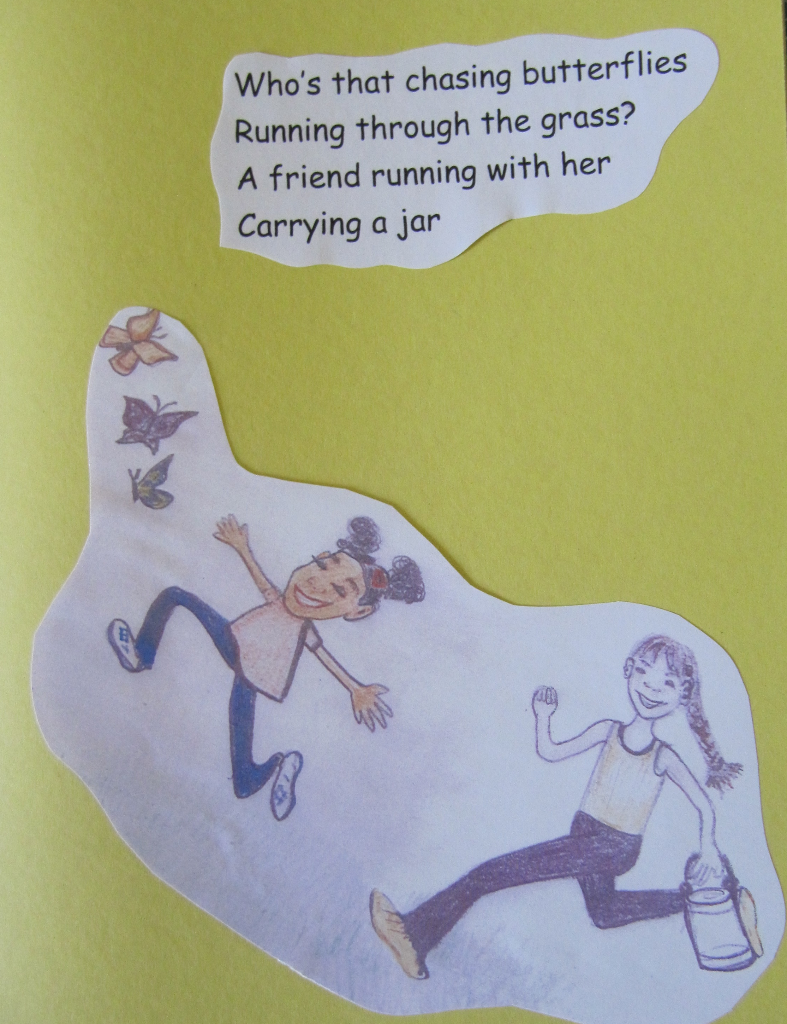

Slide 7
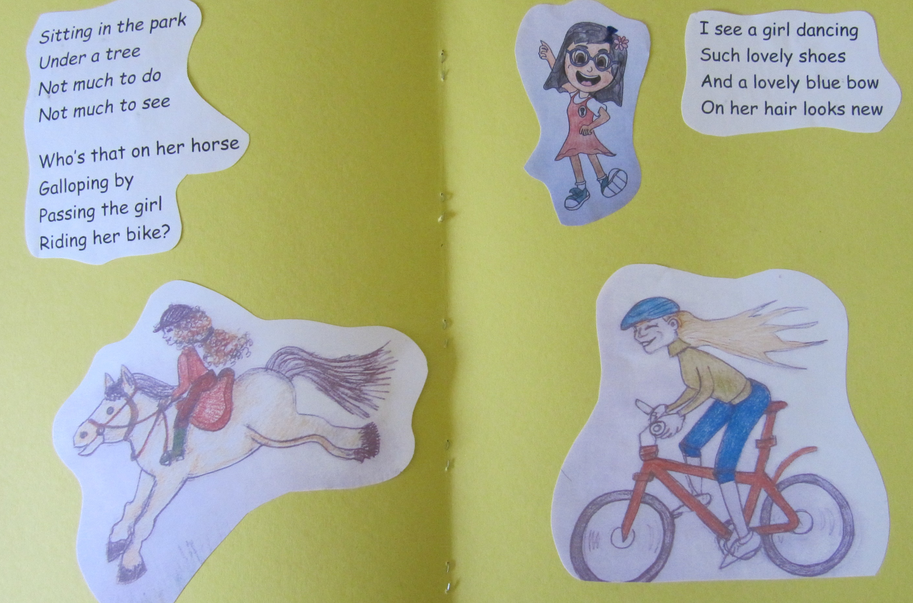

Slide 8
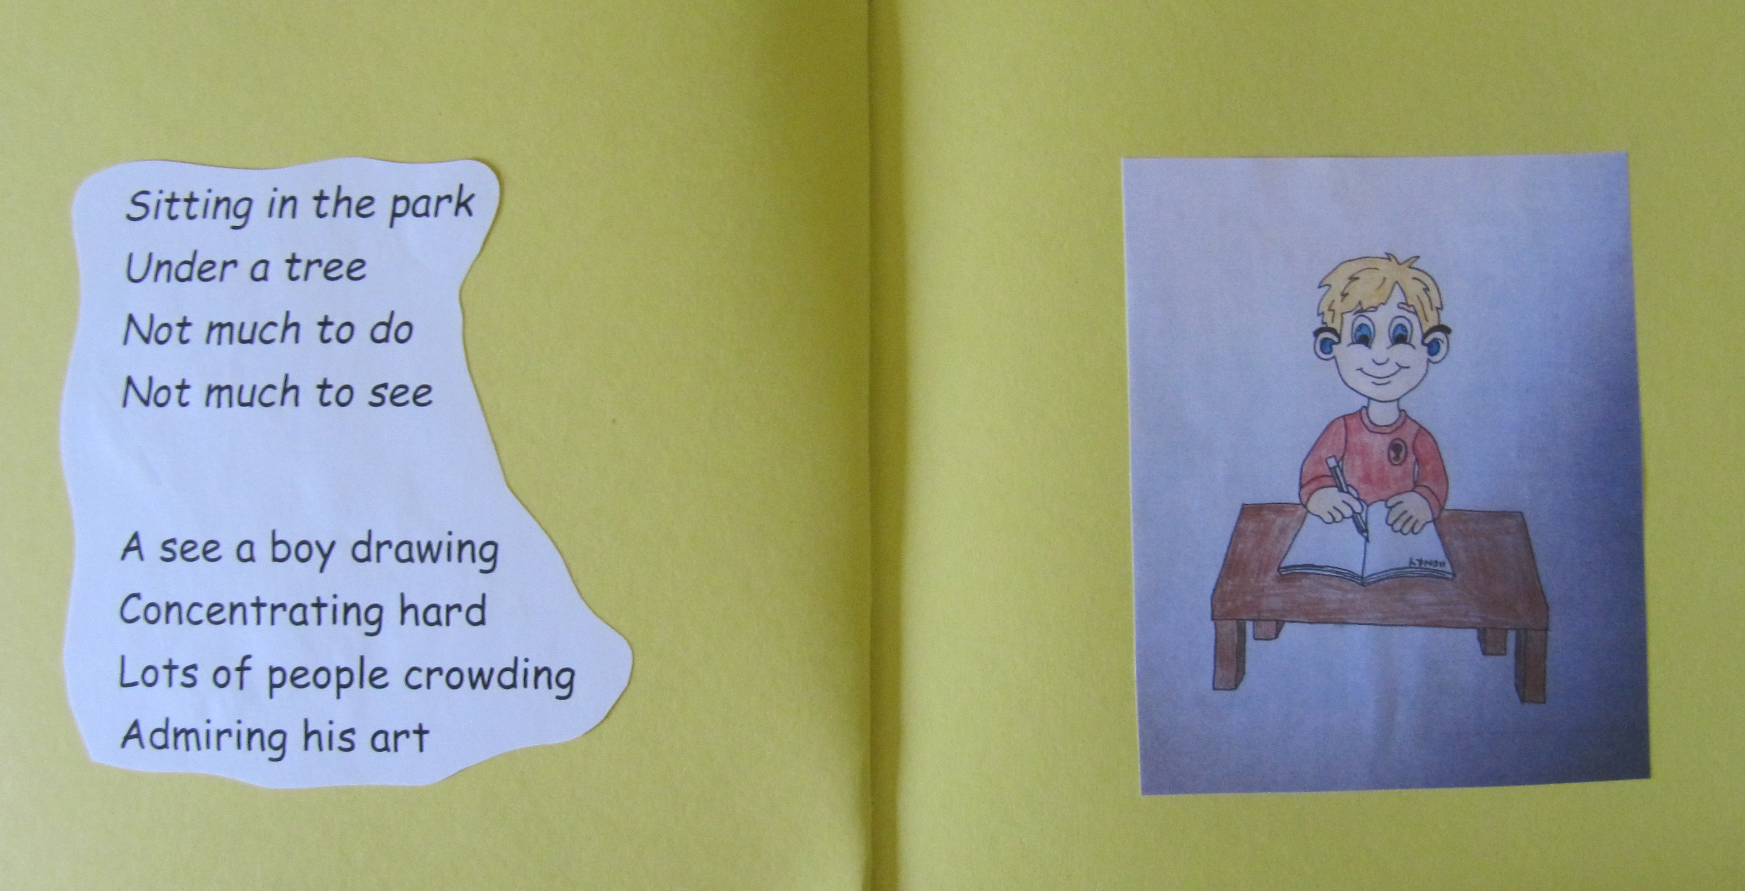

Slide 9
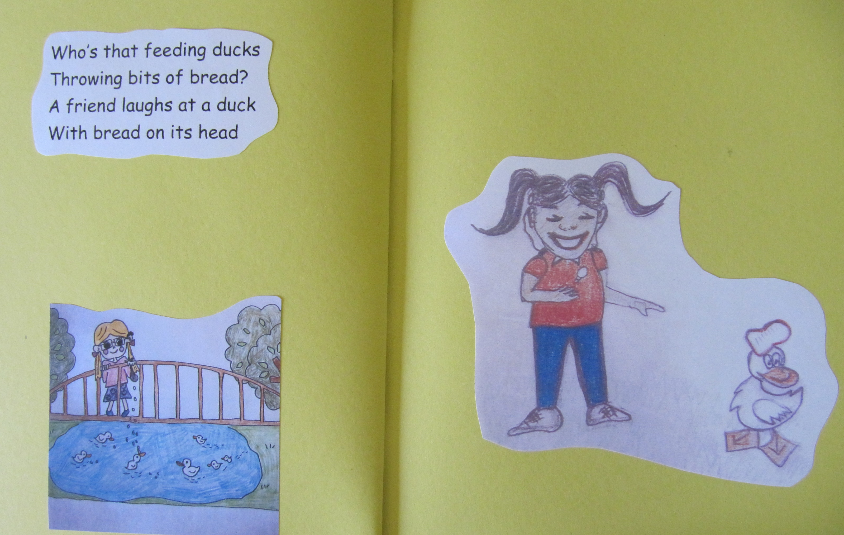

Slide 10
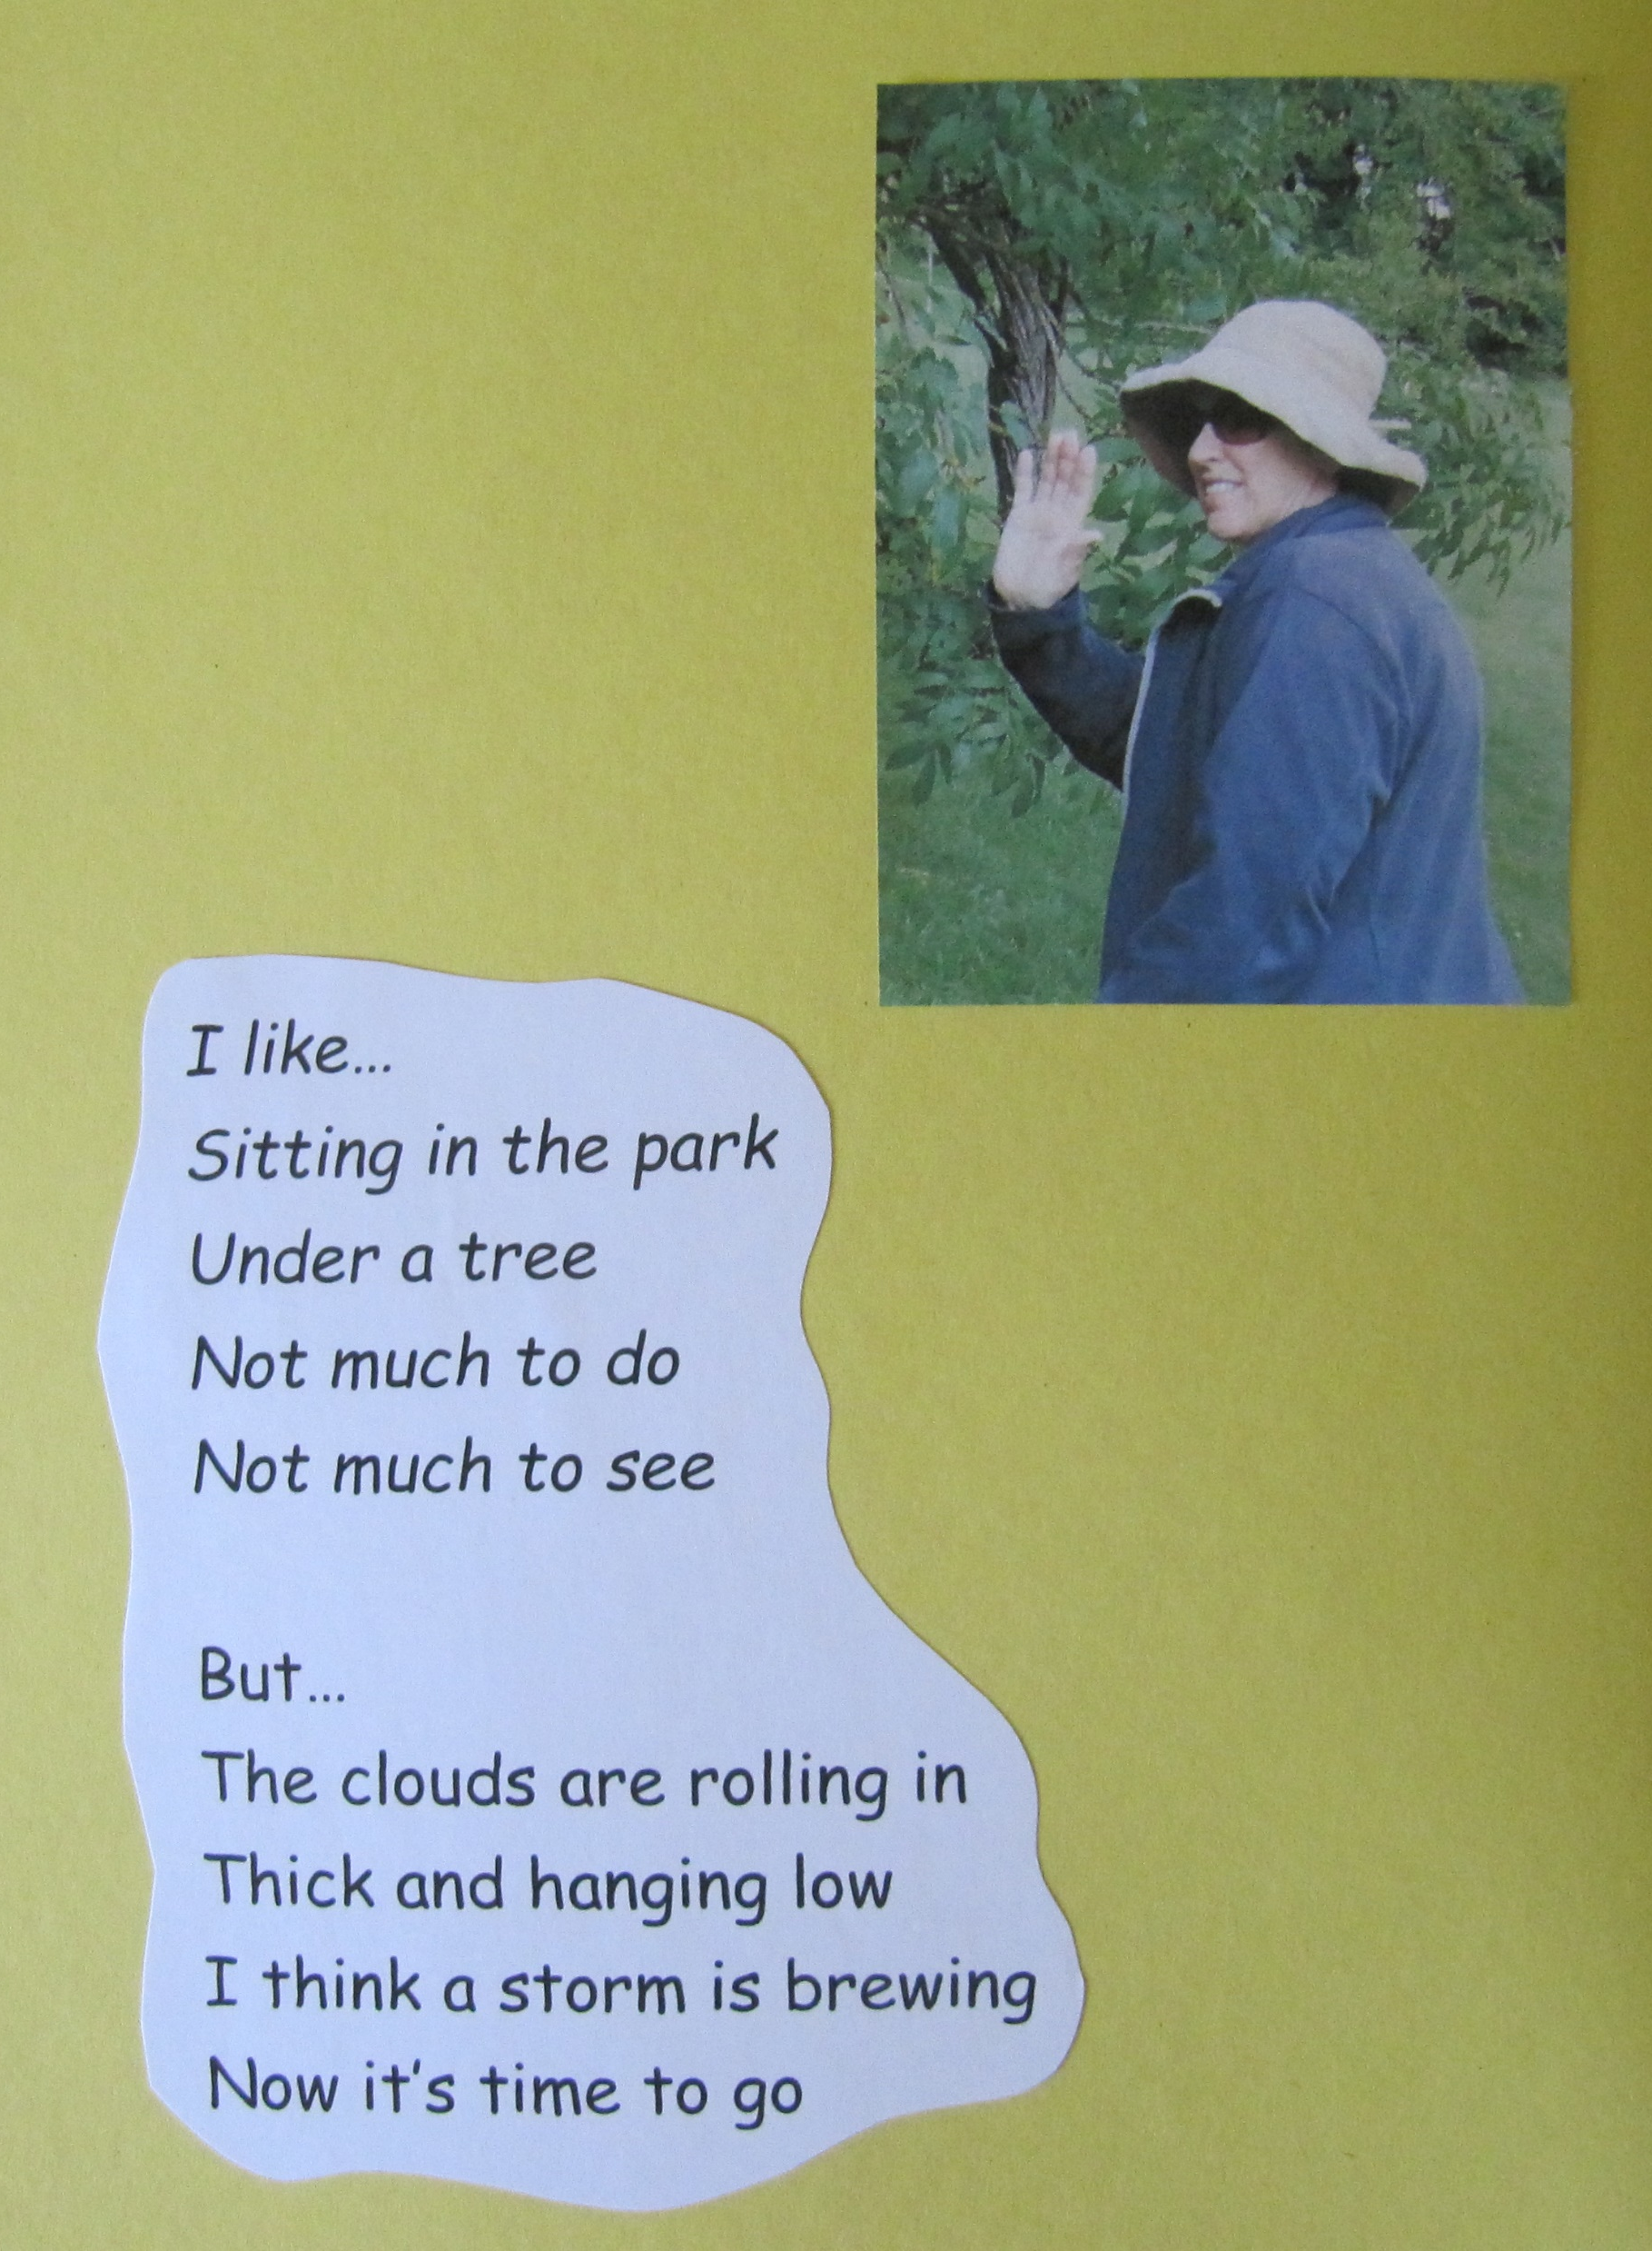

Slide 11
Thank you very much Ms Robertson and Miss Martin for the pictures. They are fab! Goodbye everyone, have a good holiday and I look forward to seeing you all back in September!
Good luck to Beny and Dakota at their new school and I hope they will visit us soon one day!
From Ms Pereira

