Slide 2
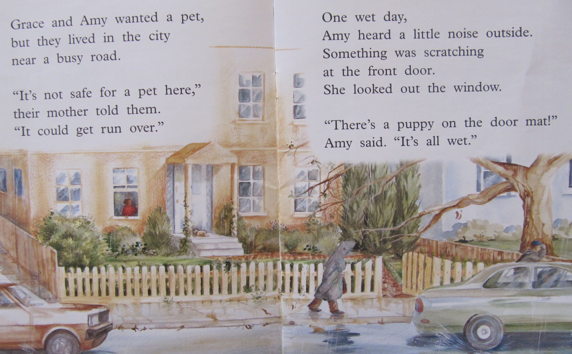

Slide 3
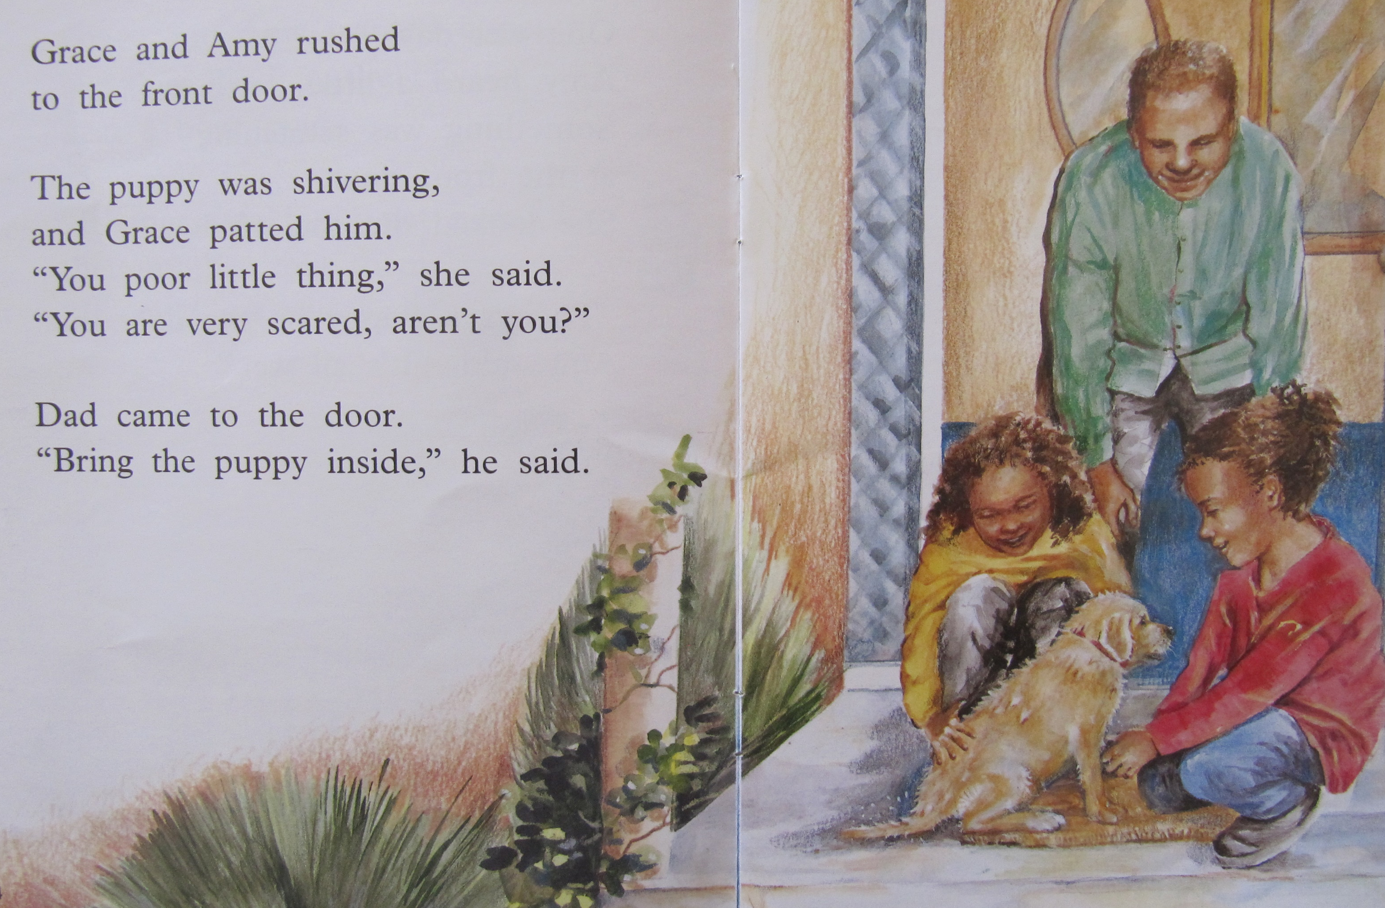

Slide 4
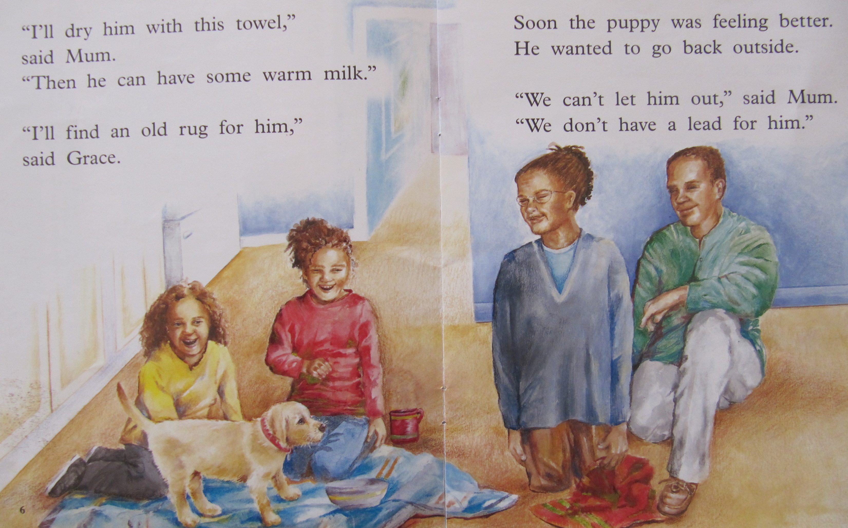

Slide 6
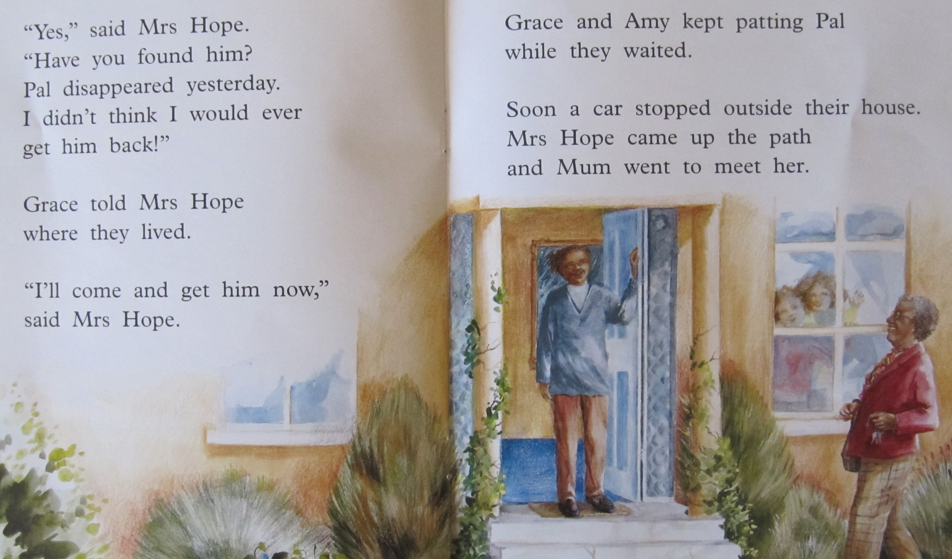

Slide 7
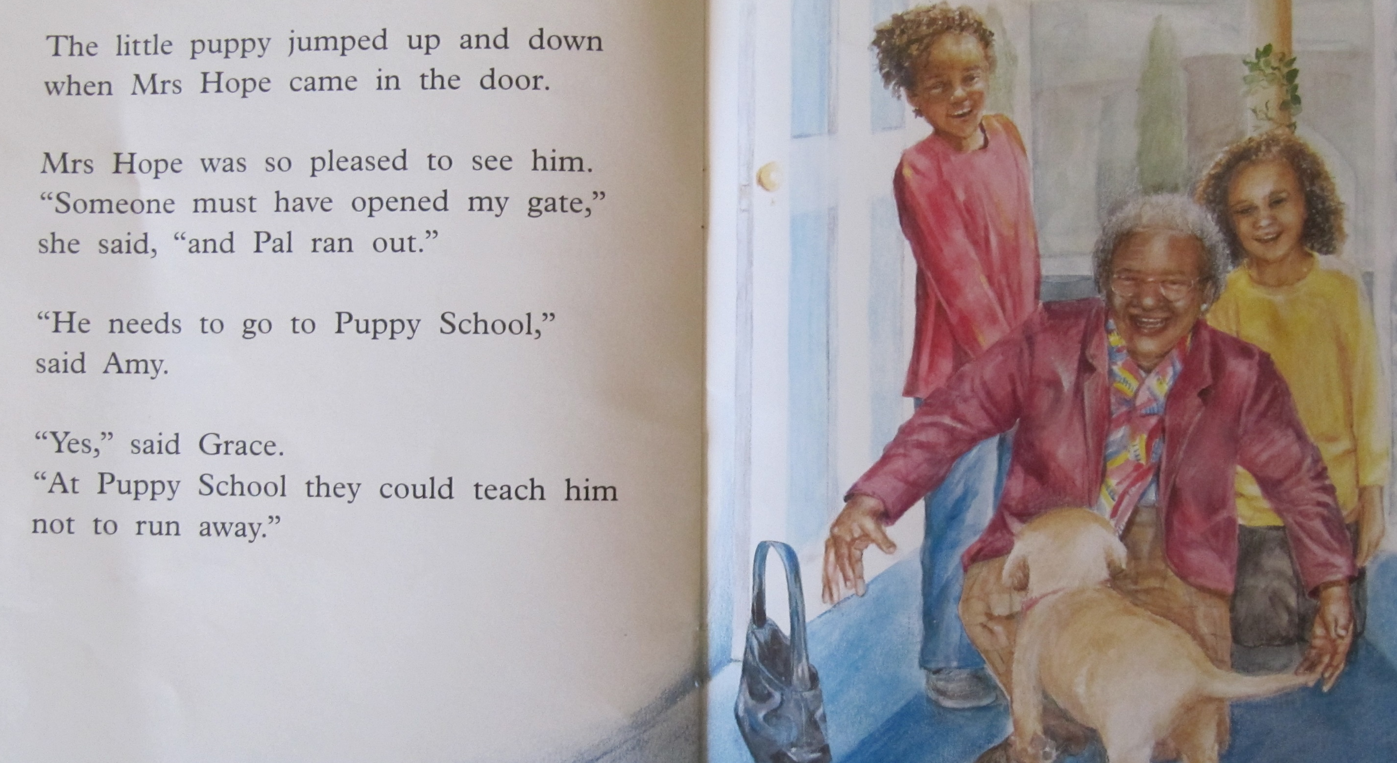

Slide 8
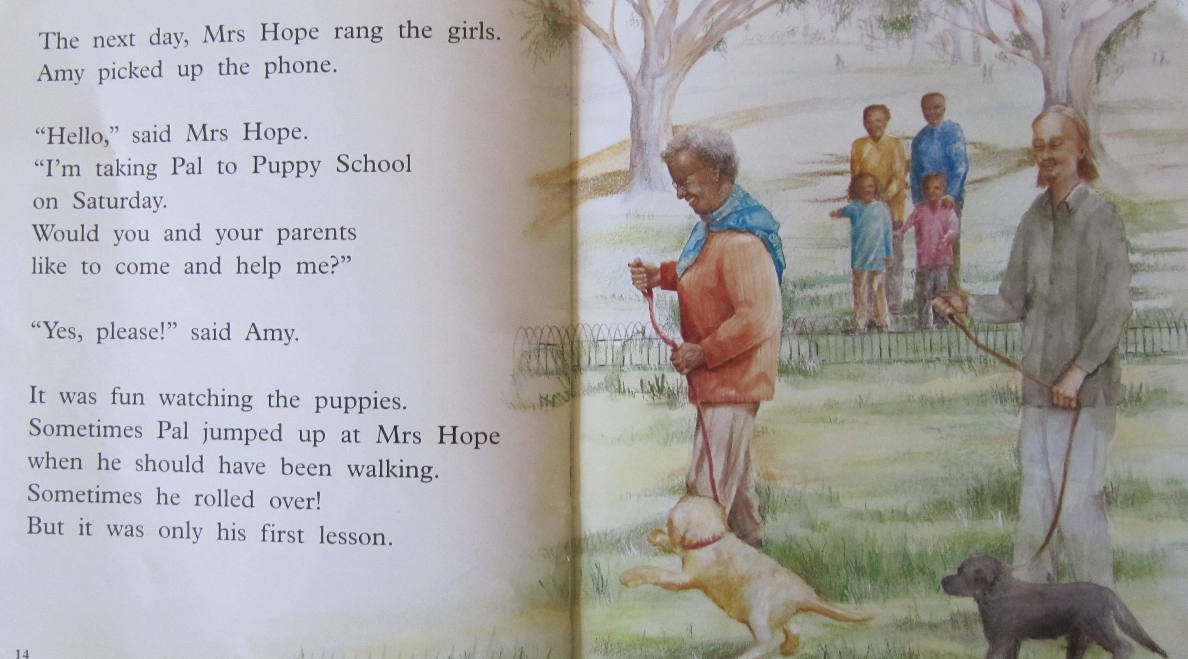

Slide 10
Questions: Why couldn’t Grace and Amy have a pet? What did Amy find at the door? How did they know who to phone? Who came to pick up the puppy? Why did Mrs Hope take the puppy to puppy school? Why do you think Mrs Hope asked the girls to come to the puppy school?
Activity:
Do you have a pet? Draw a picture and describe your pet. Write about the things you have to do to look after it, where it lives and what it eats, and how you play with your pet.
If you do not have a pet, draw a picture of what you would like to have and write about it.
You can make a poster or a booklet about your pet.

