Slide 8
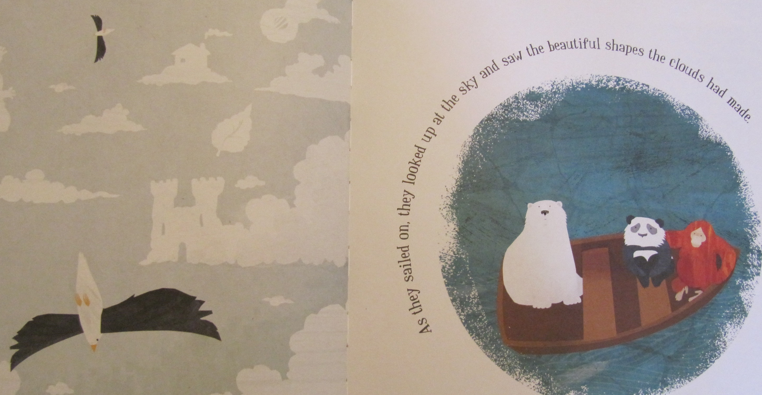

Slide 9
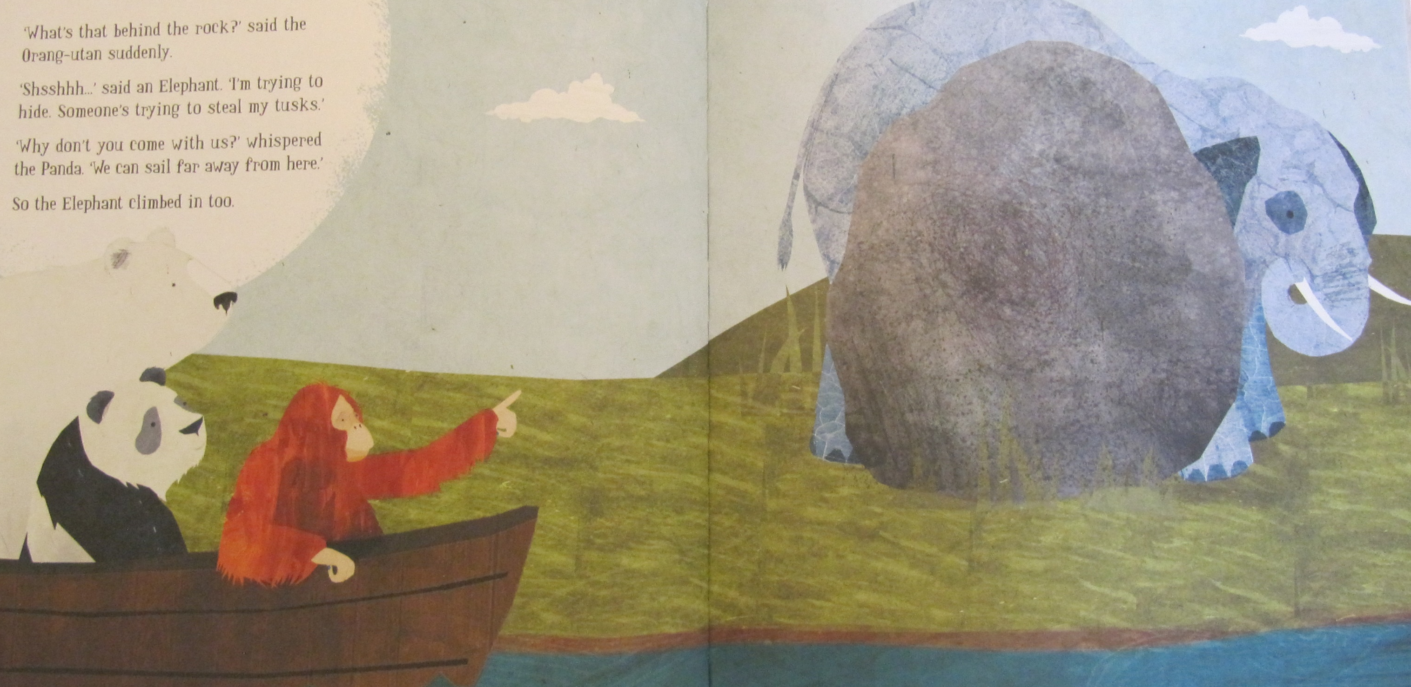

Slide 10
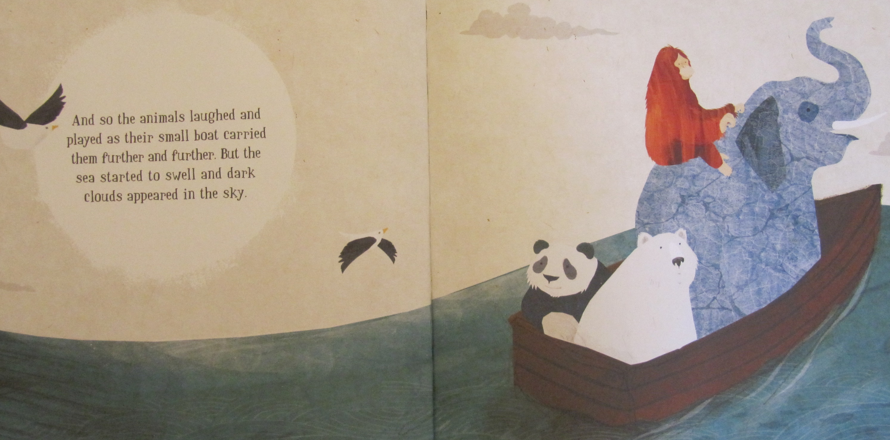

Slide 11
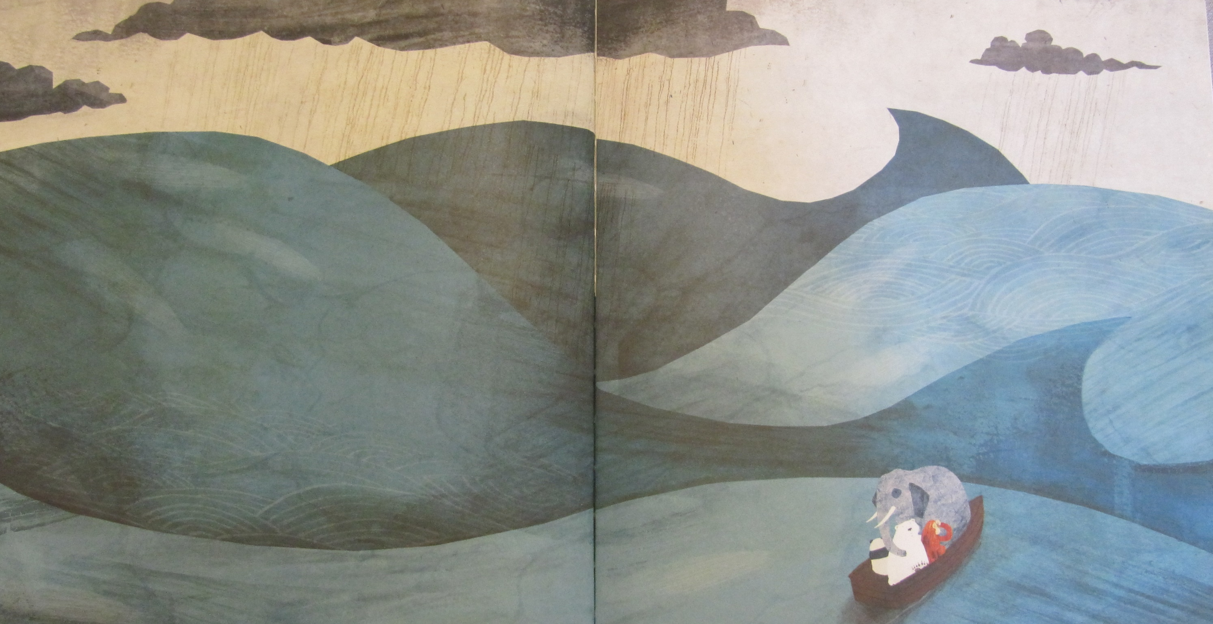

Slide 12
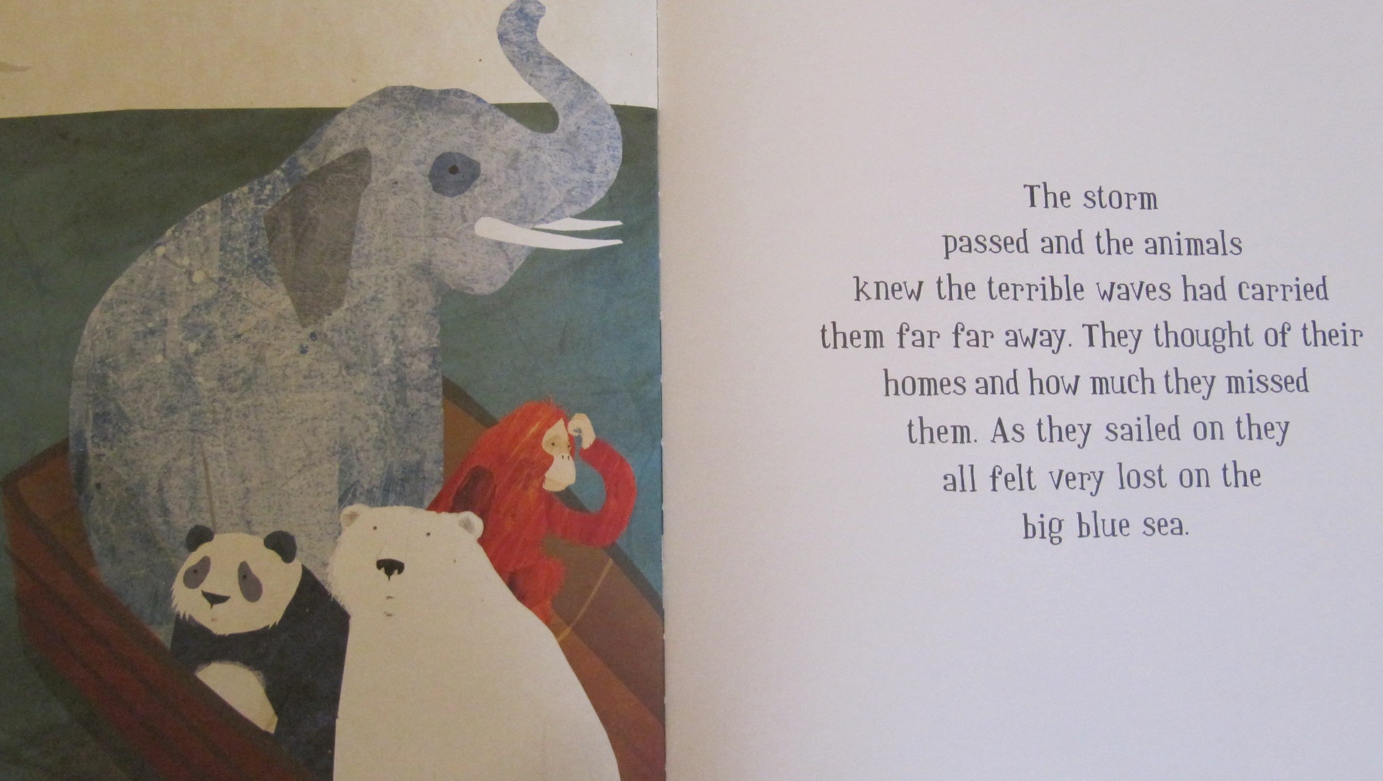

Slide 13
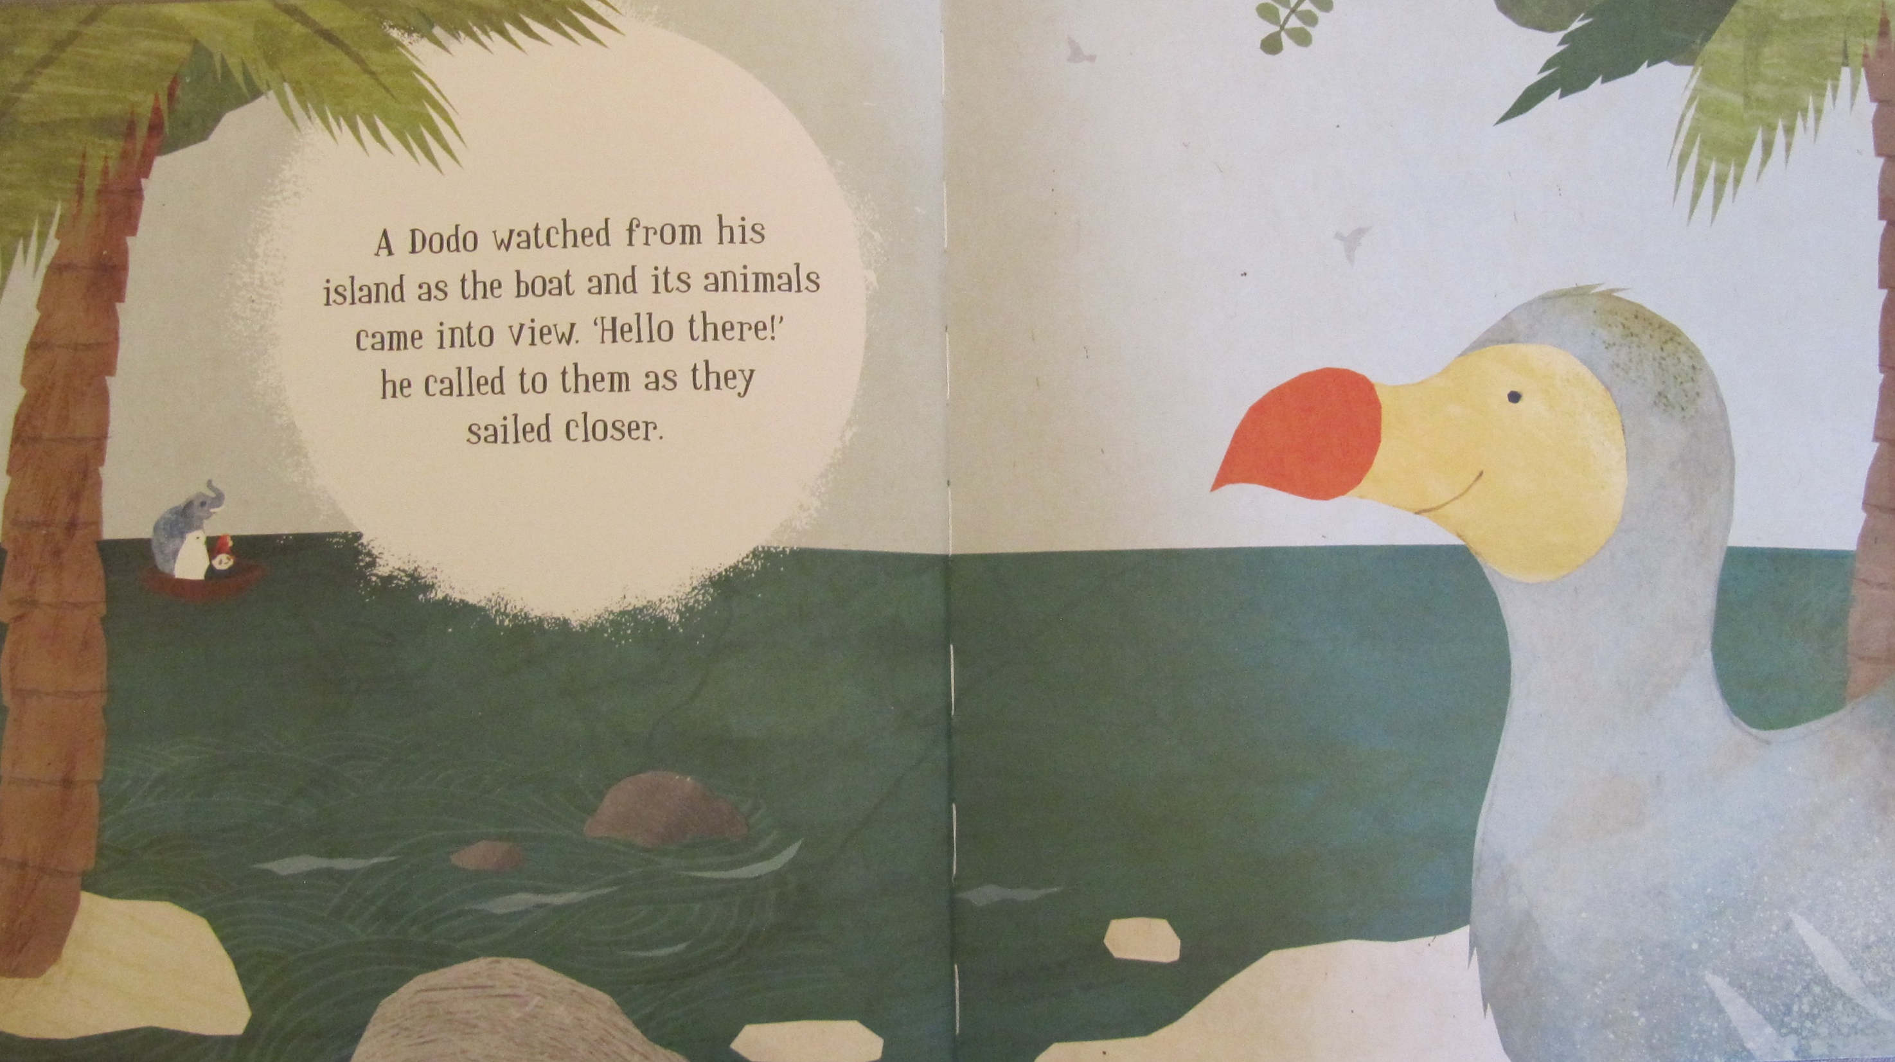

Slide 14
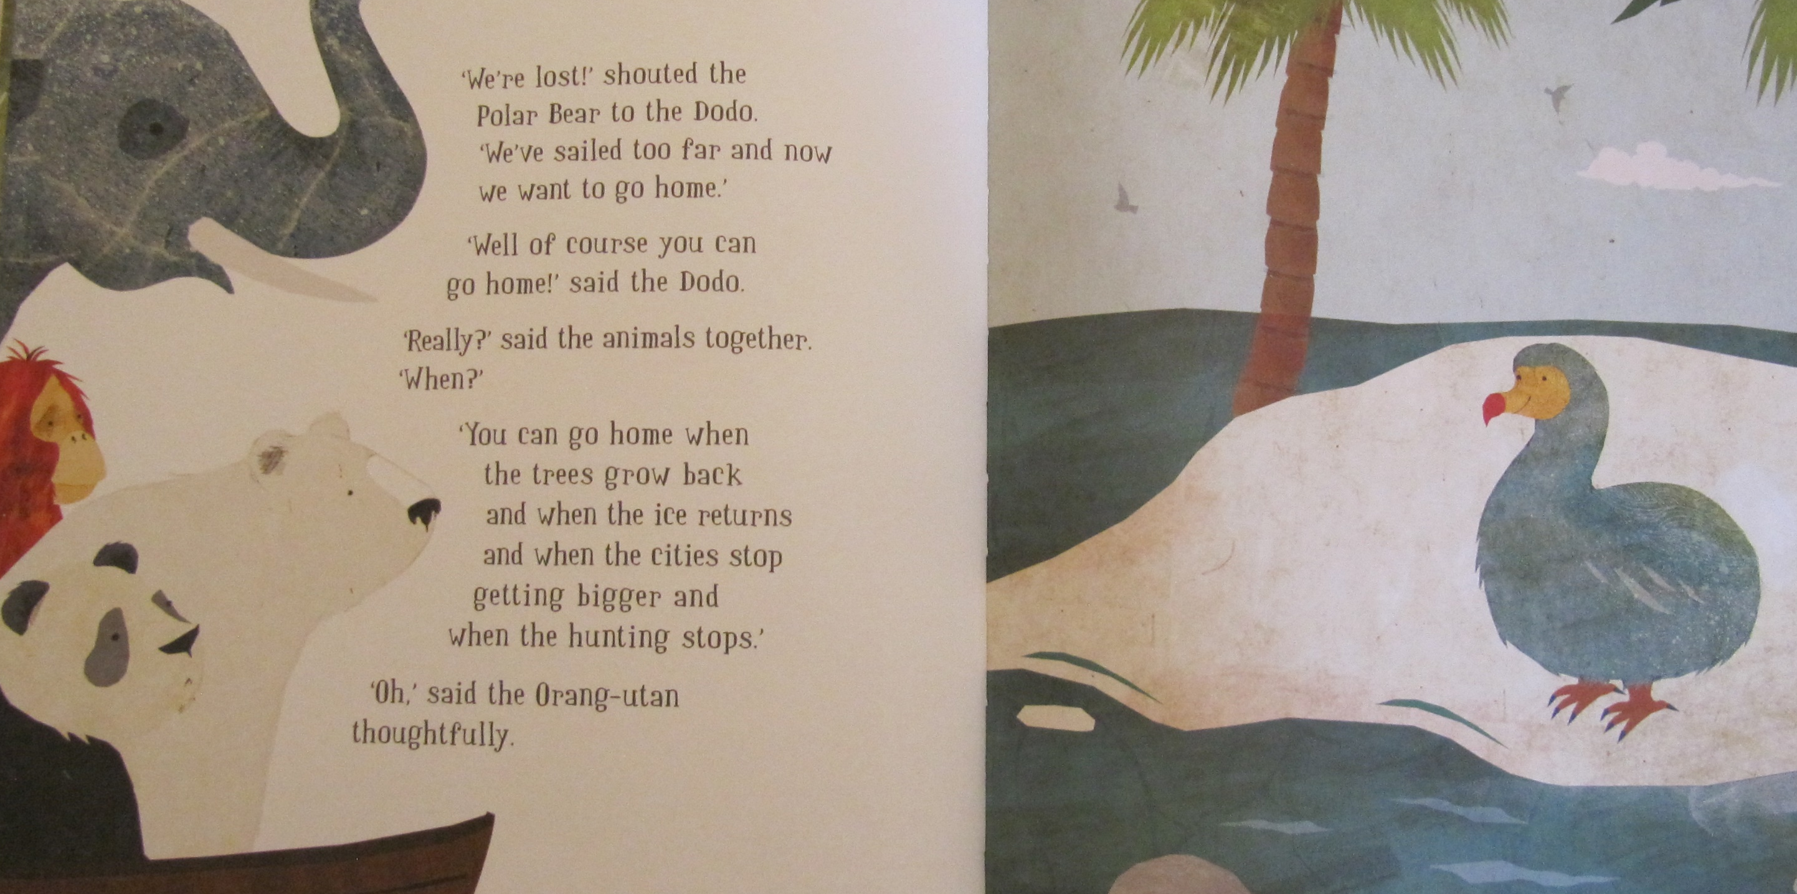

Slide 15
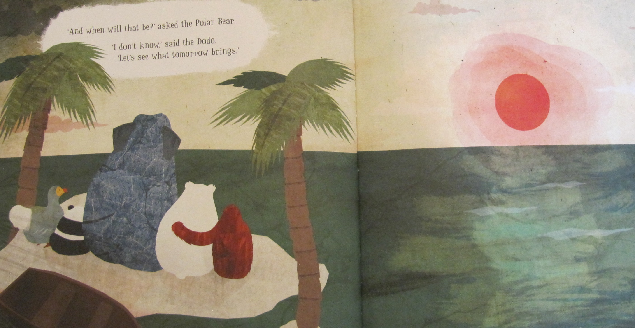

Slide 16
Now read about the five animals in the story to find out some true facts about their homes. Then do the tasks.

Slide 22
Tasks:
Draw the animals from the story and write their names. Draw a speech bubble for each animal and write why each animal had to leave their home.
Chose an animal and find out about what is happening to their habitat. Write what you think we should do to try and save the animals.
Draw a new home for each animal and describe what it should be like
What do you think will happen next. Draw the next page for the story and write what you think will happen next.

